Slide 1
The Curriculum
St Elizabeth’s School
Positive Living and Learning for People with Epilepsy and other Complex Needs
@Stelizabethsepilepsycare @St_Elizabeths @StElizabethsCEO @stelizabeths_centre @StElizabeths
www.stelizabeths.org.uk

Slide 2
The Curriculum
St Elizabeth’s School
INTENT
At St Elizabeth’s we believe that learning is a life long journey. We provide positive living and learning for people with epilepsy and other complex needs. We aim to inspire our children and young people to achieve their full potential and empower them with the knowledge, skills and attributes they will need, to enable them to become successful adults.
The aim of our curriculum is that all our young people become:
Successful, and develop a love of learning, make progress and achieve their full potential.
Develop confidence, to live a safe, happy, healthy and fulfilling lives.
Have the knowledge (where possible) to make a positive contribution to society by being responsible citizens.
IMPLEMENTATION
The implementation of our curriculum is carefully structured through mapping, schemes of learning and personalised curriculum planning. Reviews of the curriculum and its impact is monitored regularly to ensure sequential, layered knowledge and skills acquisition, and check that student outcomes are of a very high quality.
IMPACT
The aspirations for all learners here at St Elizabeth’s is for them to achieve their own individual potential, based on their own challenge threshold. Our aim is to equip our learners with a wealth of transferrable skills that they have developed throughout their time at St Elizabeth’s. The impact of our curriculum is measured by teaching and leaning observations, light touch reviews, surveys, learners work, student voice and assessment data.
@Stelizabethsepilepsycare @St_Elizabeths @StElizabethsCEO @stelizabeths_centre @StElizabeths
www.stelizabeths.org.uk

Slide 3
At St Elizabeth’s we have 3 Pathways that all have their own curriculum.
Pathway 1
Pathway 2
Pathway 3
@Stelizabethsepilepsycare @St_Elizabeths @StElizabethsCEO @stelizabeths_centre @StElizabeths
www.stelizabeths.org.uk

Slide 4
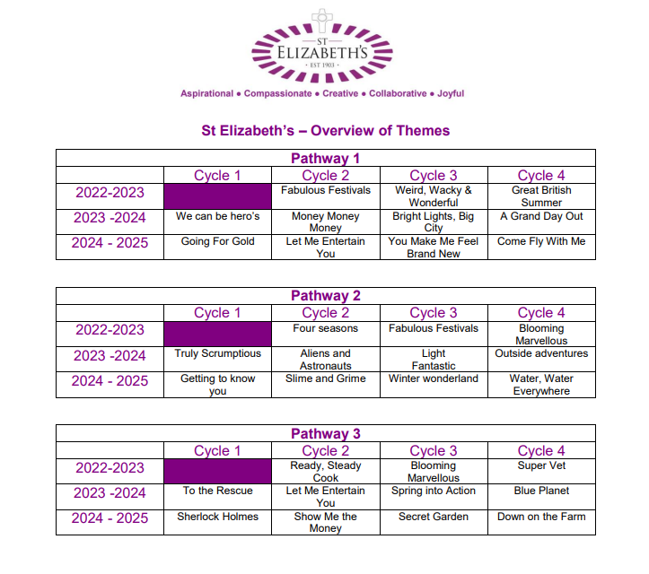
@Stelizabethsepilepsycare @St_Elizabeths @StElizabethsCEO @stelizabeths_centre @StElizabeths
www.stelizabeths.org.uk

Slide 5
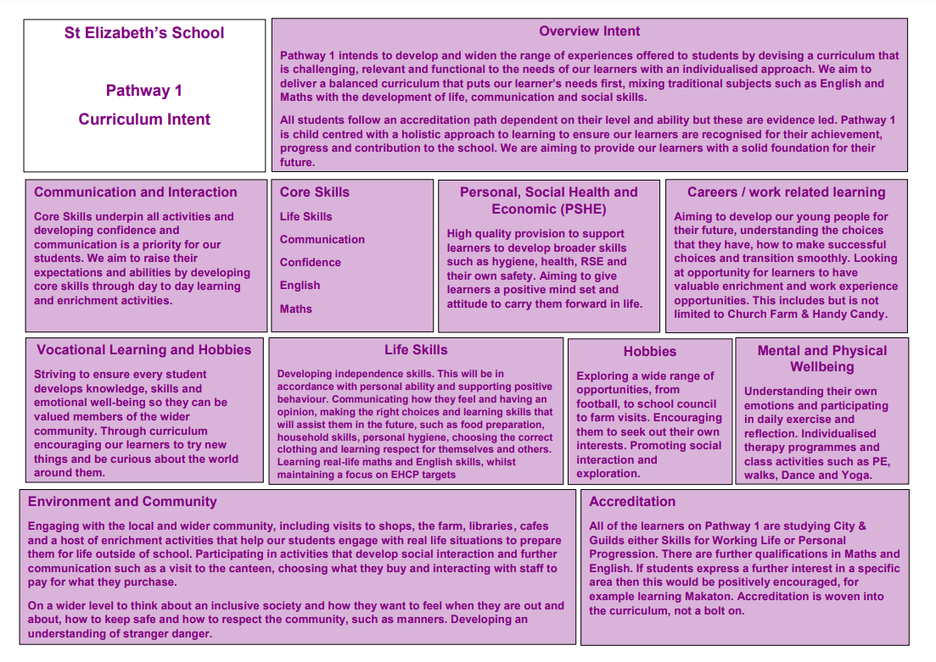
@Stelizabethsepilepsycare @St_Elizabeths @StElizabethsCEO @stelizabeths_centre @StElizabeths
www.stelizabeths.org.uk

Slide 6
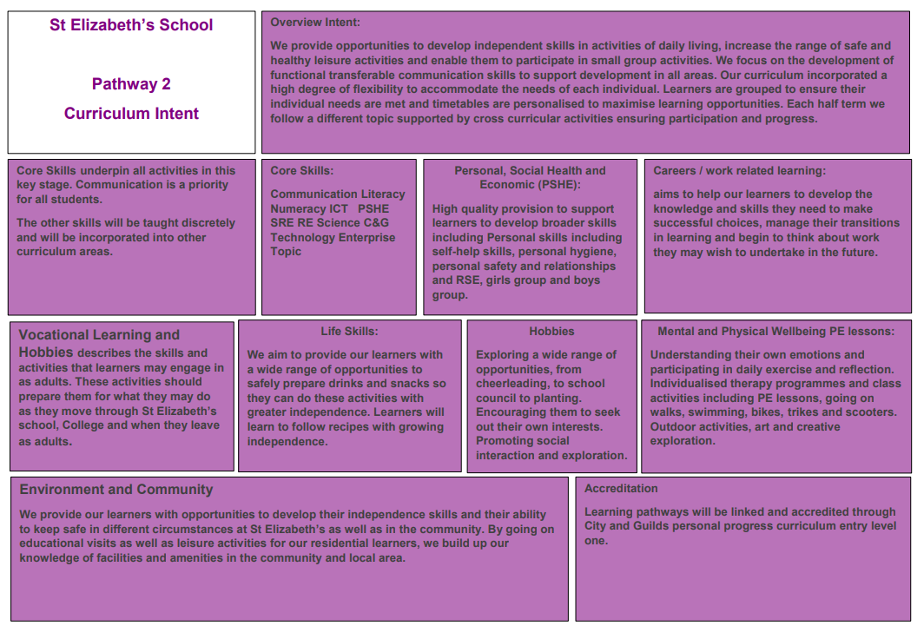
27
232
65
112
48
@Stelizabethsepilepsycare @St_Elizabeths @StElizabethsCEO @stelizabeths_centre @StElizabeths
www.stelizabeths.org.uk

Slide 7
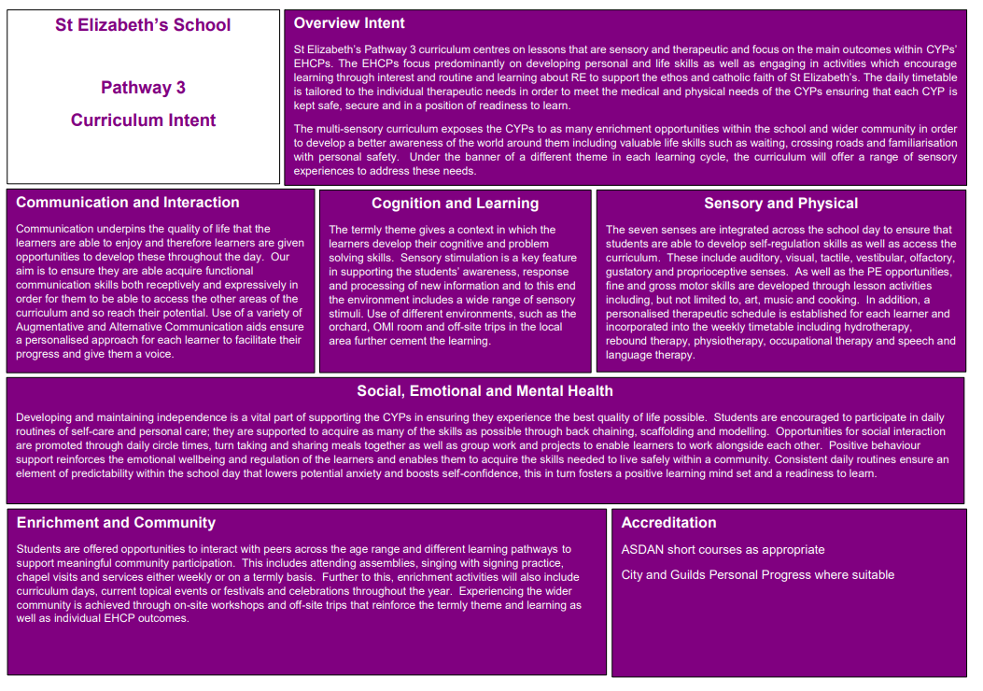
@Stelizabethsepilepsycare @St_Elizabeths @StElizabethsCEO @stelizabeths_centre @StElizabeths
www.stelizabeths.org.uk

